Slide 1








A 2-days National Level Hackathon on
AI in education
PiKO-PERSONALIZED AI GPT
COGNIFY
TRISHA RATHORE
05/SEPTEMBER/2025
SAGAR INSTITUTE OF SCIENCE AND TECHNOLOGY, GANDHI NAGAR
www.samadhan.sistec.ac.in/

Slide 2


AREA OVERVIEW
AI in Education: Transforming Learning with PiKO
Education shapes futures. AI can personalize and speed up learning. Piko is a fast, friendly AI assistant that responds quickly using phone gestures. This unique interaction makes Piko easy and fun to use for all ages.Motivation: Build Piko to stand out by combining speed, friendliness, and gesture control. To create a friendly AI assistant (Piko) that anyone can customize and use easily.Image suggestion: Friendly AI face with students
IMPORTANCE OF AREA
Education shapes futures. AI can personalize and speed up learning.
AI helps teachers and students by automating tasks and giving instant support.
Motivation: Build Piko, a friendly, customizable AI assistant for everyone.

Slide 3
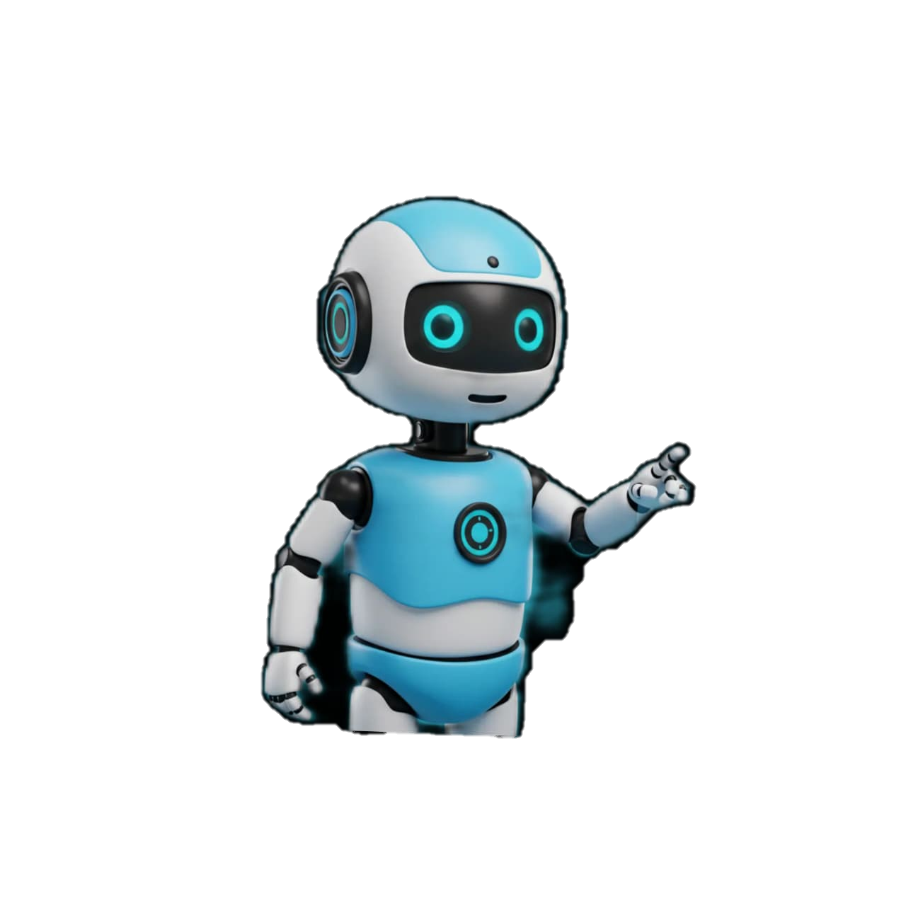
Potential Challenges and Opportunities
Challenges: Large class sizes, limited teacher time, language barriers, and slow feedback.Opportunities: AI can provide 24/7 help, personalized learning, and automate grading.AI can improve education quality and make learning accessible to all.Image suggestion: Split image showing challenges (crowded classroom) and AI solutions (student using AI on tablet).
Opportunities for AI Instant
doubt solving through a voice chatbot
improves learning speed. Personalized answers
adapted to a student’s level enhance education quality
Multi-language support breaks language barriers.
Automation of common queries saves teachers’ time,
letting them focus on deeper teaching.
Challenges: Overloaded teachers, slow feedback, language gaps.
AI can offer 24/7 help, personalized learning, and automate grading
Opportunity: Boost education quality and access worldwide.
Challenges / Pain Points
Many students hesitate to ask questions
in class due to shyness or fear of judgment.
Typing barriers or language difficulties make
online learning harder.

Slide 4
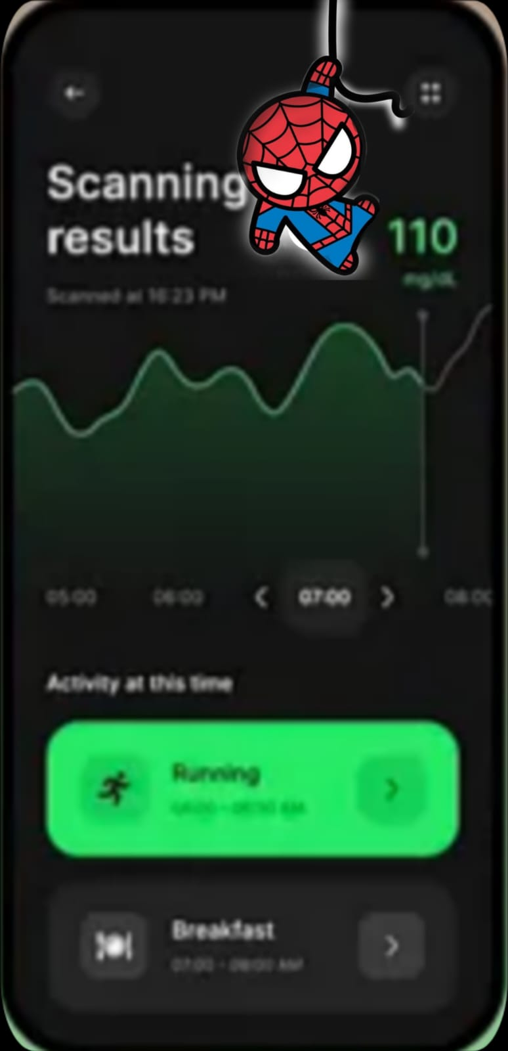



Preliminary Solution Concept
PiKO: Your Personalized AI Education Assistant
Piko answers questions, explains concepts, and helps with homework.Simplifies learning by providing instant, easy-to-understand answers.Supports smooth transitions between topics and subjects.Image suggestion: AI assistant icon with chat bubbles showing Q&A.
PiKO FACES
[User Asks Question]
Piko AI Processes Question
Provides Instant Answer
Supports Learning & Topic Transition

Slide 5

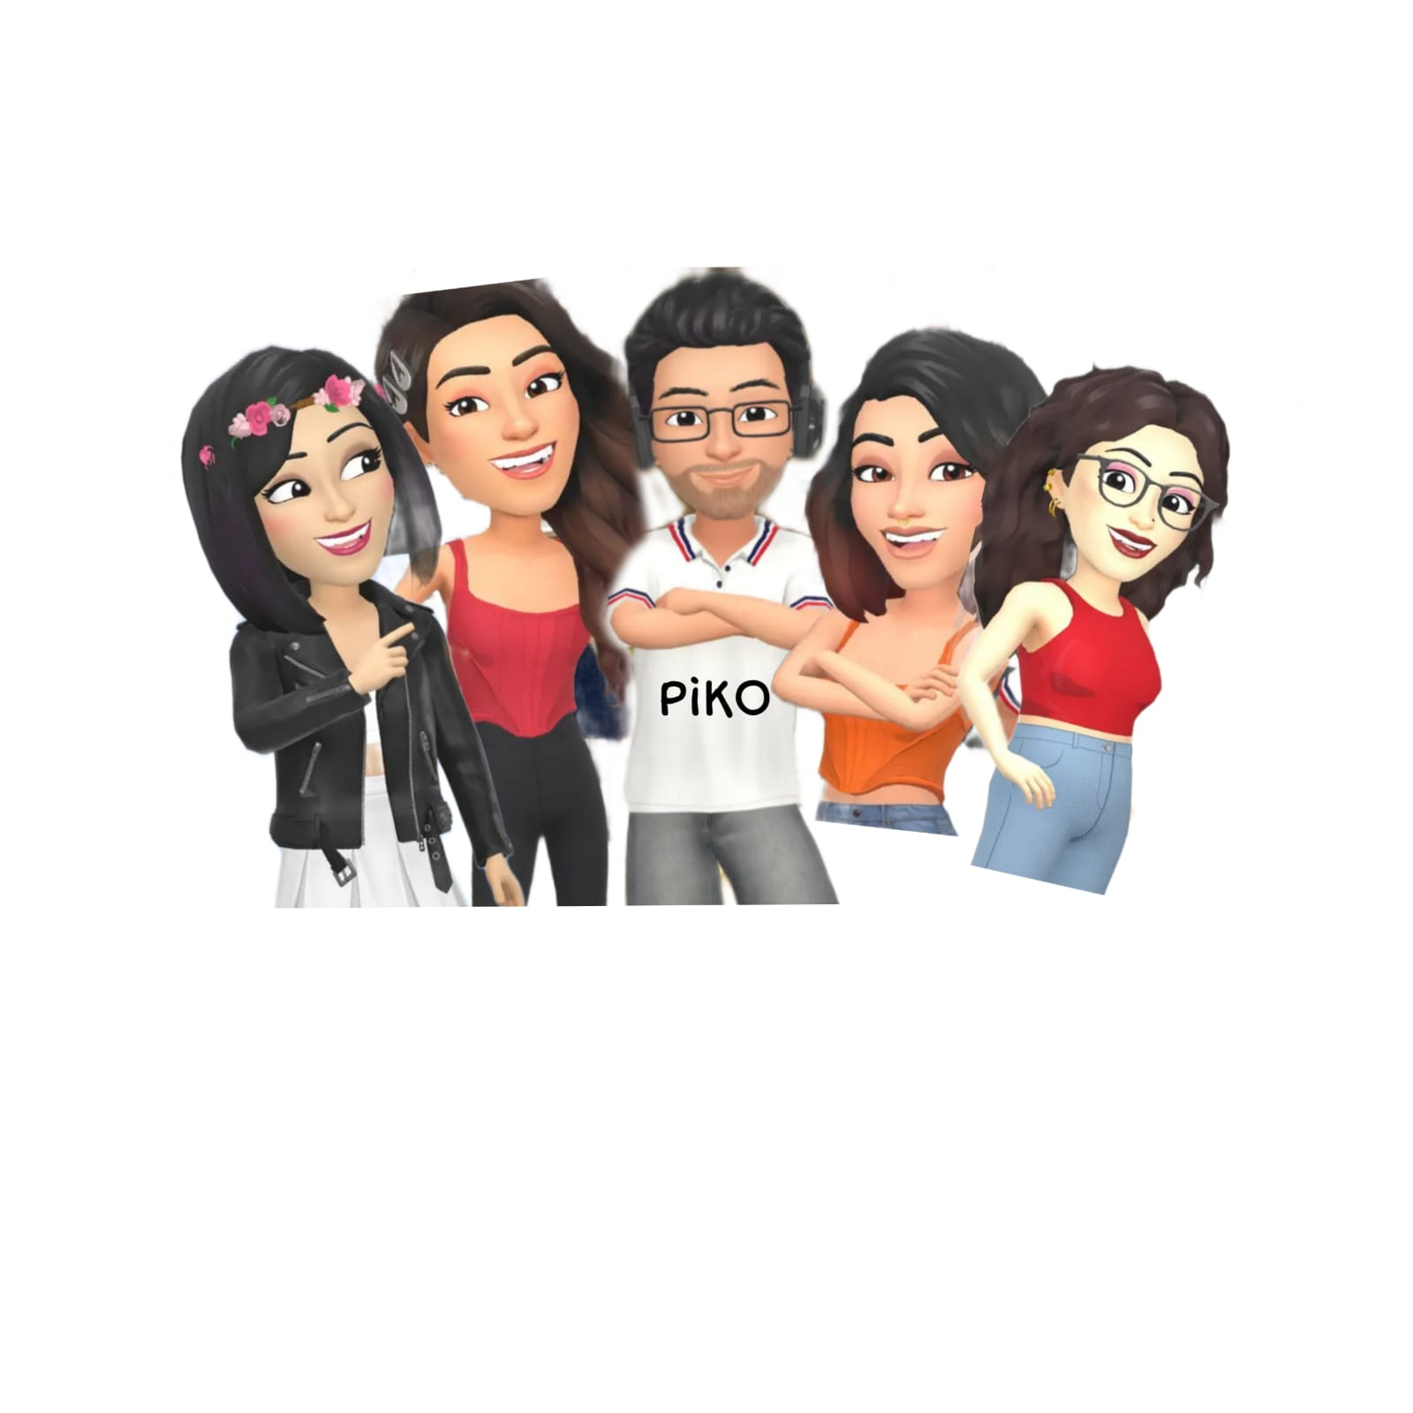

Key Features and Functionalities
Essential Features of Piko
Personalized AI face that users can customize.24/7 availability for help anytime.Multilingual support for global users.Automated task handling like reminders and grading assistance.Image suggestion: Customizable AI face options and icons for 24/7, languages, automation.
Customizable friendly AI face.
Always available (24/7).
Multilingual support.Automates
reminders and grading help.

Slide 6

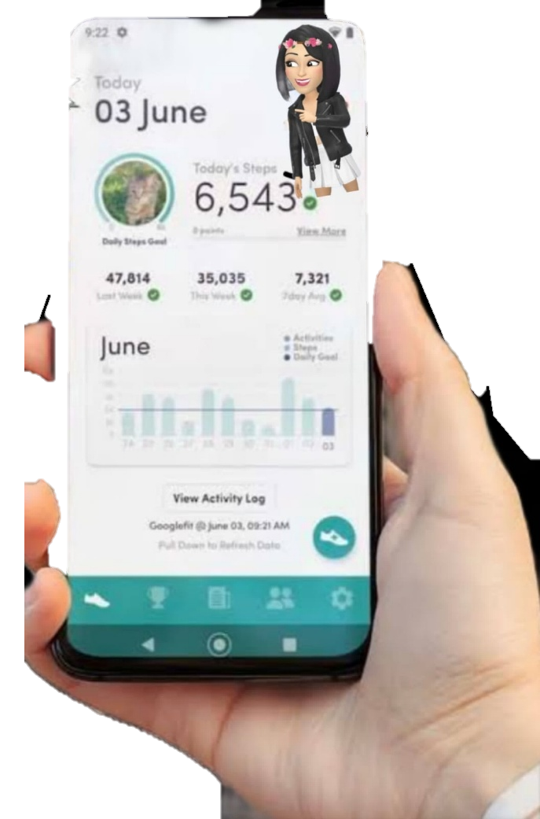

Target Users and Expected Use Cases
Who Will Use Piko?
Students of all ages, teachers, and parents.Use cases: Homework help, exam preparation, lesson explanations, and progress tracking.Image suggestion: Diverse group of students and teachers interacting with devices.
Who Benefits & HowStudents, teachers, parents.
Use cases: Homework help, exam prep, lesson support.
Students – Primary users who ask questions, track assignments, and revise with the chat bot.
Teachers/Educators – Use it to reduce repetitive queries and support students outside class.
Parents – Track progress, deadlines, and receive updates on their child’s learning.

Slide 7
Data Requirements and Privacy Considerations
Data & Privacy Considerations
Data needed: Questions asked, learning progress, language preferences.Data collected securely with user consent. Strong privacy measures to protect personal info.Image suggestion: Lock icon with data flow or shield symbol.
DATA REQUIREMENTS ?
PURPOSE,
DATA MINIMIZATION,
SPECIFY DATA TYPE,
TRANSPARENCY,
LEGAL
COMPLICATIONS,
INFORM CONSENT
How Data Could Be Gathered / Processed
Voice input
converted to text using speech recognition.
Natural Language Processing (NLP) to understand questions.
Calendar/notes integration to track deadlines.
Continuous learning from student interactions to personalize tools
Type of Data Required Student Queries
– Voice or text
questions asked to the chatbot. Learning Preferences –
Subjects, difficulty level, favorite learning style.
Assignments & Deadlines – Due dates, task details,
reminders. Usage Data – Interaction history, quiz results,
saved notes/facts. Language & Accessibility Needs –
Preferred language, speech patterns.
Collects questions, progress, preferences.Secure storage with user consent.Strong privacy protection

Slide 8
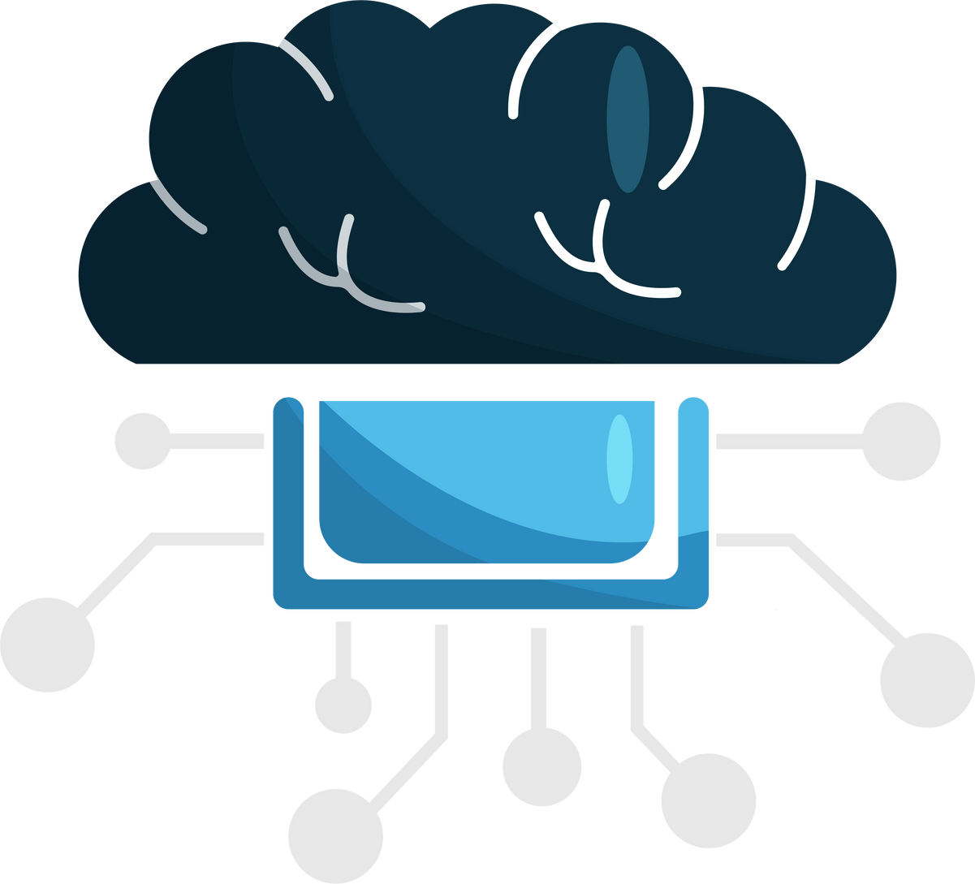

AI Technologies and Methods
Technologies Behind PiKO
Natural Language Processing (NLP) to understand questions.Machine Learning to improve answers over time.Data analysis to personalize learning paths.Image suggestion: AI brain or neural network graphic.
AI assistants predominantly rely on a combination of Natural Language Processing (NLP), Machine Learning (ML), and Large Language Models (LLMs) to understand human language, learn from interactions, and generate relevant, human-like responses
advanced language models to continuous learning algorithms

Slide 9





Implementation Approach
Building & Deploying Piko
Use tools like Python, TensorFlow, and cloud platforms.Development phases: Prototype → Testing → Launch.Timeline: 6-9 months with flexibility for improvements.
Phase 1
Research & Design Define
scope, features (Q&A, deadlines,personalization). Design creative UI/UX (student-friendly, simple voice-first). Tools: Figma / Canva for mockups
Phase 2 –
Core Development Frontend
React + Tailwind (UI), Mic & Speaker integration. Backend: Node.js / Express for APIs. AI Models: NLP → OpenAI API / Hugging Face Transformers. Speech → Google Speech-to-Text, Coqui TTS. Database → Firebase / MongoDB for storing user data, deadline
Phase 3 –
Smart Features Add personalization engine (track habits &shortcuts). Assignment & Deadline tracker with calendar sync. AI Debate partner (Q&A + counterarguments). Micro-learning suggestions (short quizzes, summaries
Phase 4 –
Testing & Iteration
Test with small group of students. Collect feedback, fix bugs, improve accuracy
Tools: Python, TensorFlow, Cloud.Steps: Prototype → Test → Launch.Timeline: 6-9 months, flexible.
This Photo by Unknown Author is licensed under CC BY-SA-NC

Slide 10
Evaluation Metrics
Measuring PiKO’s Success
Metrics: Response time, answer accuracy, user satisfaction, engagement rates.Impact: Better learning outcomes, saved teacher time, higher student confidence.Image suggestion: Bar chart or KPI dashboard.
Metrics:- Response speed, accuracy, user satisfaction.Benefits Better learning, saved time, higher engagement.
Key Metrics / KPIs
Response Time ⚡ – Avg. time to answer student questions.
Answer Accuracy ✅ – % of correct/helpful responses.
User Engagement 📈 – Daily active users, repeat usage.
Task Completion 📅 – No. of assignments tracked & reminders used.
Personalization Success 🎯 – How often students use customized shortcuts/tools.
Student Feedback ⭐ – Ratings, satisfaction surveys, qualitative feedback
PiKO
Friendly AI for Education Makes learning easy and personal. Custom AI face builds connection.
Next: Build prototype, get feedback, improve.

